Slide 1

Special Notes
Dear colleagues,
You know that a sentences may be completed in different ways, So to understand the full meaning of the sentence, students have to write the question on the answer script and then they will complete it. Completed part must be underlined. Only answer should not be written in the answer script. It is wrong. It is notable that after completing all the sentences , it will express a complete sense of an event or a topic because all the grammar items are now a days contextual. Necessary notes are given below the slide . Please follow it before going to present it in the class.
Your near and dear
Md. Hasan Hafizur Rahman
Cambrian School & College
Dhaka
Notes:
This option is very important. If you want to make the class fruitful, please follow the instructions in this option carefully before present it in the class.

Slide 2

Welcome to the valley
of HHR PPT World
Notes:
Welcome slide.

Slide 3
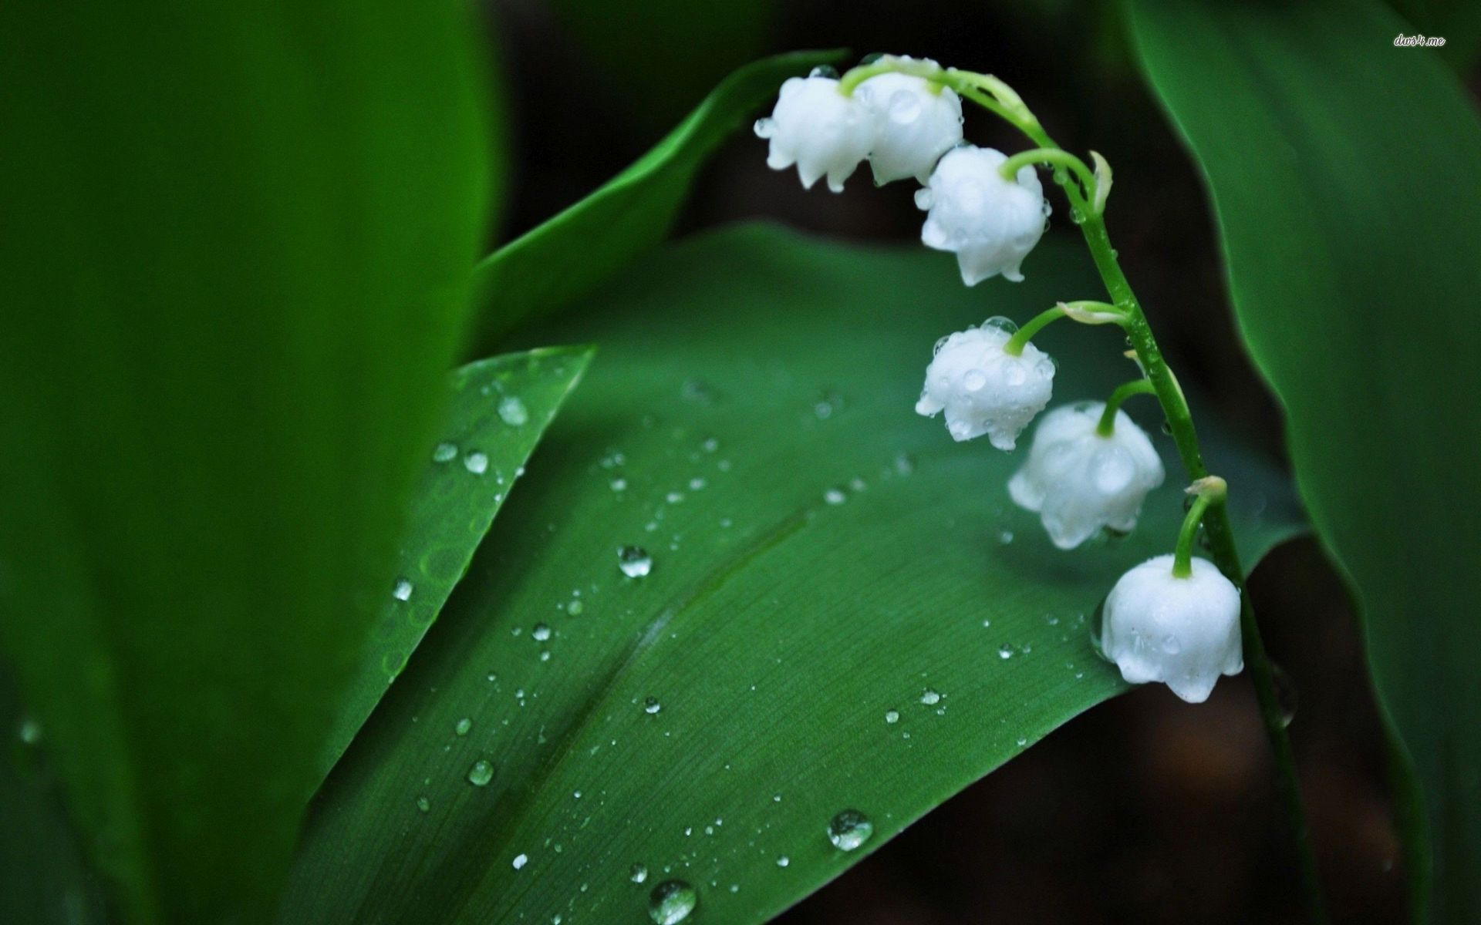
Introduction
Md. Hasan Hafizur Rahman
Lecturer and Head of the Department (English)
Cambrian School & College
Baridhara, Dhaka
Presentation made for
Class IX-X
English 2nd paper
Grammar
Notes:
Introduction of the teacher and the class.

Slide 4
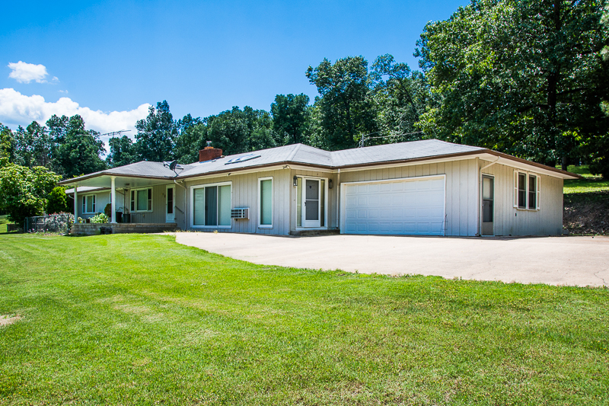
This is the house
where I lived in.
What is to be done with the sentence?
The sentence is
to be completed
Notes:
Suspension and lesson declaration.

Slide 5

Our today’s lesson is-
Completing sentence

Slide 6

Learning outcomes
At the end of the lesson , we will be able to –
identify some items of completing sentence
identify the formation of completing sentence
complete incomplete sentences
Notes:
The above outcomes will be achieved from this content.

Slide 7
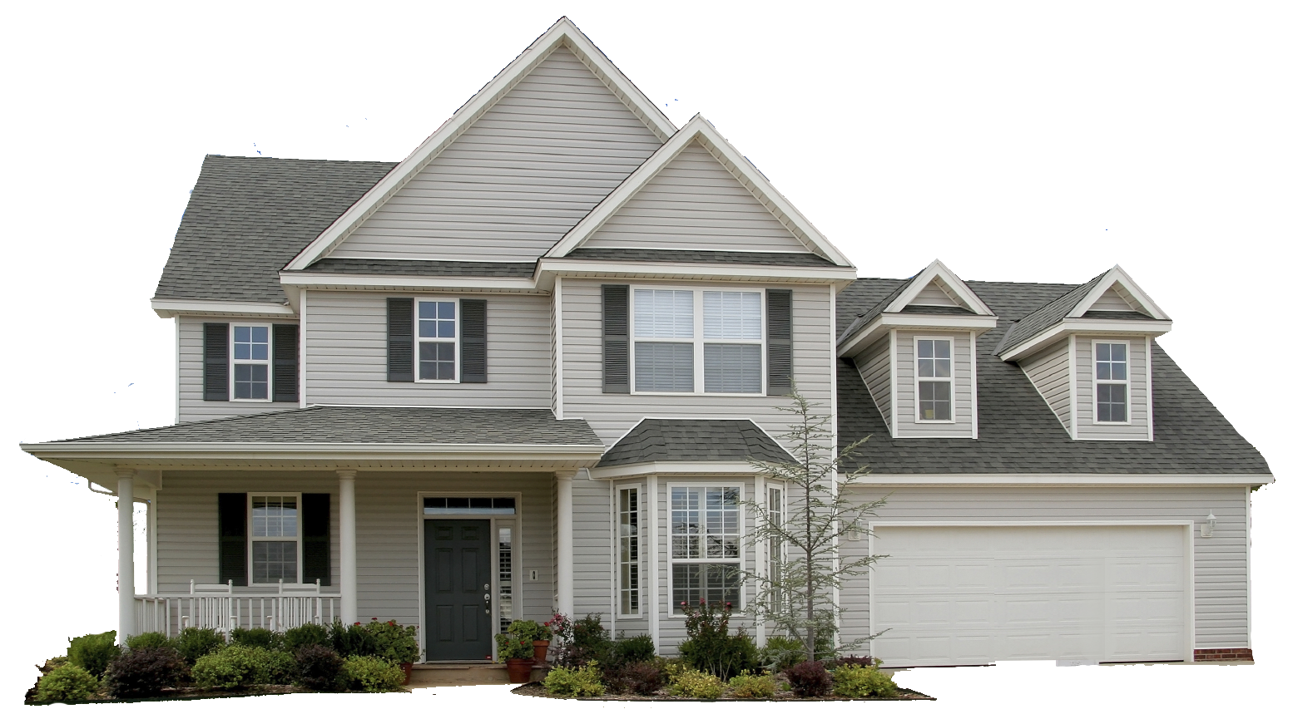
Completing item -22
How to complete a sentence
with ‘relative pronouns/words’.
(who, which, what, that, when, while, where, why, who, whom, whose, how)
This is the house that
I built.
Formation: Given item with relative pronoun/word + relevant clause
Notes:
Because of/on account of/due to/owing to এর বাংলা অর্থ ‘কারনে / জন্যে ‘

Slide 8

Activities
Check your answers
looked blue.
I saw the sky which ____________
There was a plane that______________
___________________ looked white.
The plane was on the runway what_______________.
________________________ , I was enjoying it very much.
was taking off.
The plane which I saw
was launching
When The plane was taking off
Notes:
It is for feed back.

Slide 9
Completing item -23
Use of ‘Without + gerund’.
Formation: Given without + gerund + subject (personal)
+can not/could not +verb + extension.
Without reading attentively______________________________
you cannot make a good result.
Now complete the following in complete sentences
Without taking physical exercise_____________________________.
__________________________ without writing much.
Without respecting others___________________________________.
______________________ you cannot win prizes.
Without taking medicine ___________________________________.
Notes:
Without + gerund may have at the beginning or at the end.

Slide 10


Completing item -24
Use of ‘If conditional (1st conditional)’.
If + Subject +V₁ +, + subject + will + V₁
If you come, I will go.
Main Focus
will
V₁
1st Conditional
Structure : If + Present + Future/Present modal
First conditional describes a particular situation not in general/ not habitual.
Notes:
Detail description of First conditional. Please go on with animation accordingly.

Slide 11
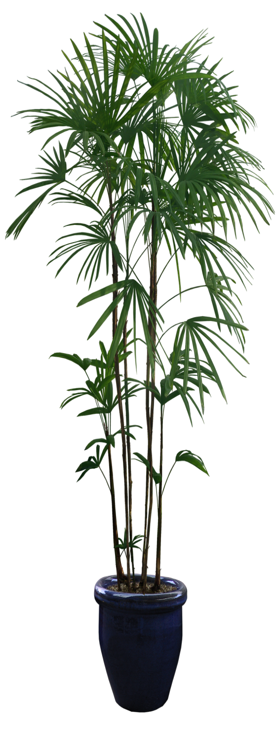
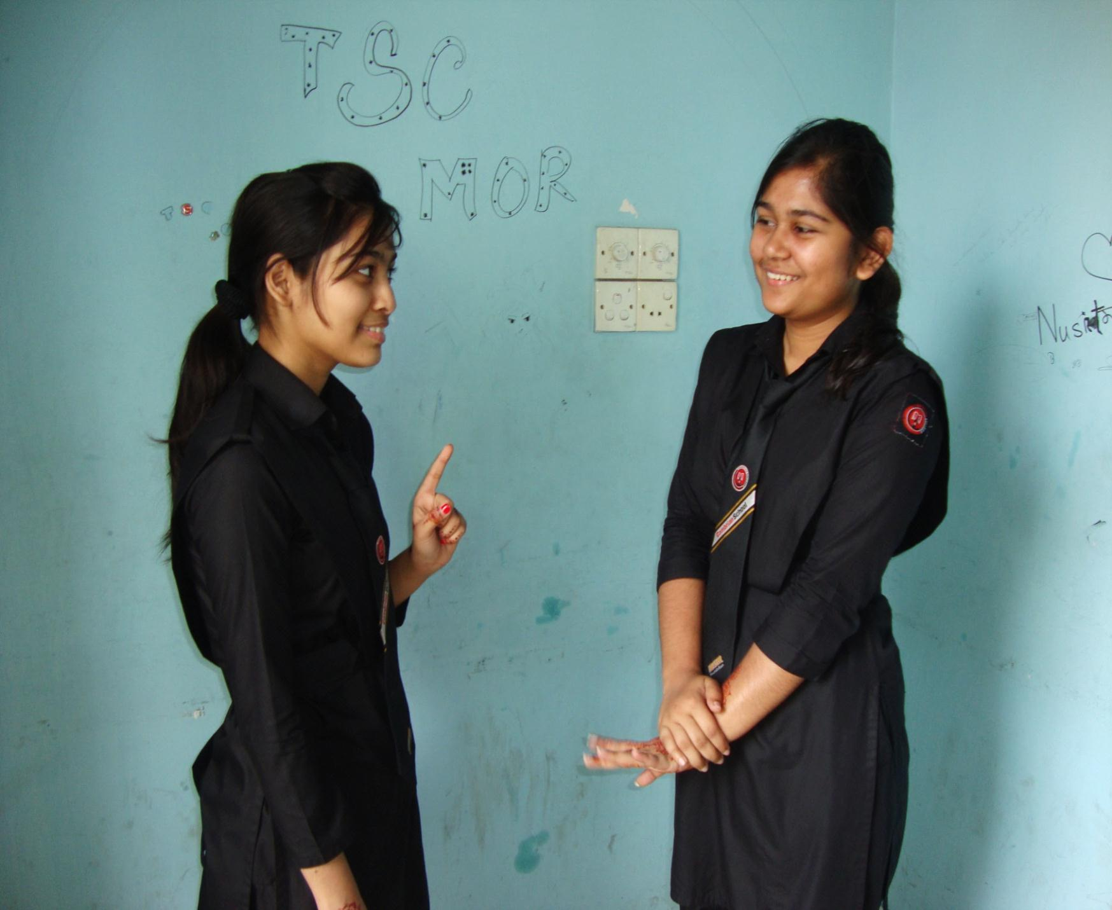
If you study regularly,____________________________
you will do better in the exam.
Notes:
First conditional according to If + Present + Future.

Slide 12
Completing item -25
Use of ‘If conditional (2nd conditional)’.
If + Subject +V₂ +, + subject + would + V₁
If you came, I would go.
Main Focus
would
V₂
2nd Conditional
Structure : If + Past simple + Past Modal
Second conditional is used to talk about something in the present which is impossible, because it's not true.
Notes:
2nd conditional is detected in details through animation accordingly.

Slide 13
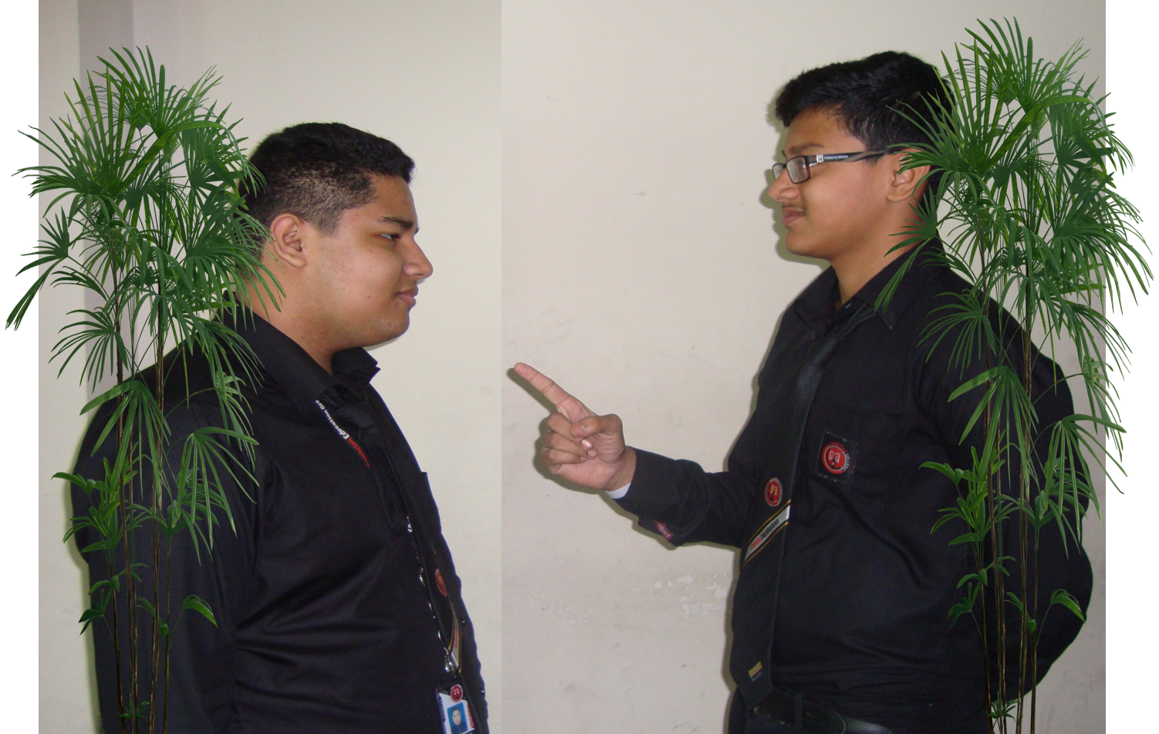
You would do well __________________
if you followed me.
Notes:
2nd conditional according to If + past + Future past.

Slide 14


Completing item -26
Use of ‘If conditional (3rd conditional)’.
If + Subject +had +V₃ +, + subject + would have + V₃
If you had come, I would have gone.
Main Focus
would have + V₃
had +V₃
3rd Conditional
If + Past perfect + Future perfect in the past.
It talks about the past. It's used to describe a situation that didn't happen, and to imagine the result of this situation.
Notes:
Teacher may conduct third conditional according to animation.

Slide 15
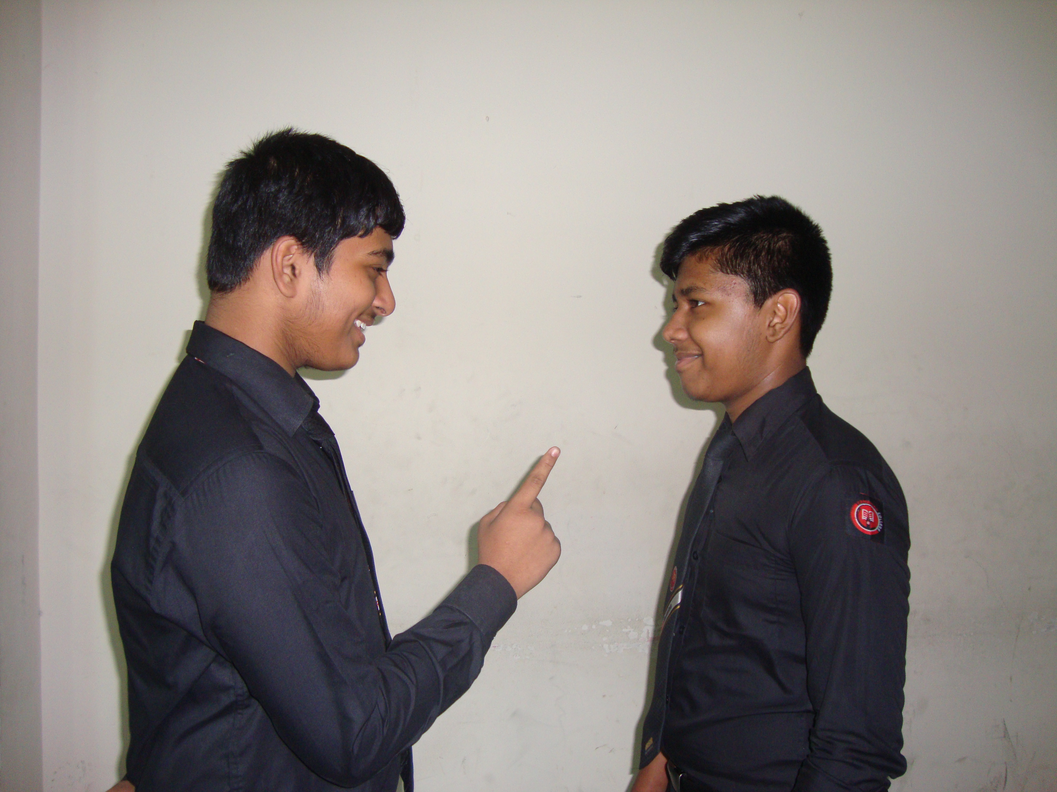
I would have been pleased so much.
If you had given me the book, ________________________________
Notes:
Example of 3rd conditional.

Slide 16

Completing item -27
Use of ‘If conditional (Zero conditional-Universal Truth)’.
Zero Conditional = If + present +present
they keep fit.
1. If people eat balance diet,___________
2. If you are ill,_______________
3. _________ if they don't eat.
4. ____________ if you mix hydrogen and oxygen.
5. __________ if they are scared.
6. If babies are hungry, ________
you go to doctor.
People die
You get water
Snakes bite
they cry.
Notes:
Go according to animation.

Slide 17

If rose blooms,________________
it looks beautiful.
Notes:
Zero conditional always refers to present indefinite tense in both the sides.

Slide 18
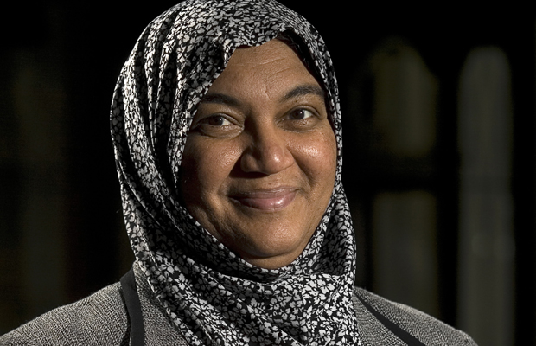
Completing item -28
Use of ‘As/Since.
Formation:
Sub-ordinate clause with AS/Since
+ related principal clause.
As my mother does all the best for me,__________________________
I can do everything for her.
Notes:
If AS/Since is at the beginning, comma (,) is used after this option. If as/since is used at the middle, no comma (,) is used.

Slide 19
Activities
Since he is ill, ____________________________.
_________________________as I respect all.
Since it is morning,________________________
_____________________I will help him.
As he is my teacher,_______________________.
Notes:
It is for feed back.

Slide 20


Completing item -29
Use of Would that/ I wish
I wish __________
I were a bird.
Notes:
If there is I wish/ Would that, next sentence will be past indefinite tense. You may ask more sentences yourself.

Slide 21
Completing item -30
Use of so much/ so many
You have so much money _____________________
that you can buy a car.
I have so many problems
that I cannot solve.
Complete the following
I have not so much time_______________________
There are so many stars in the sky_____________________
They plucked so many flowers _____________________
Notes:
Go according to animation.

Slide 22

May Allah bless you all.
Notes:
Ending slide.

